Slide 1
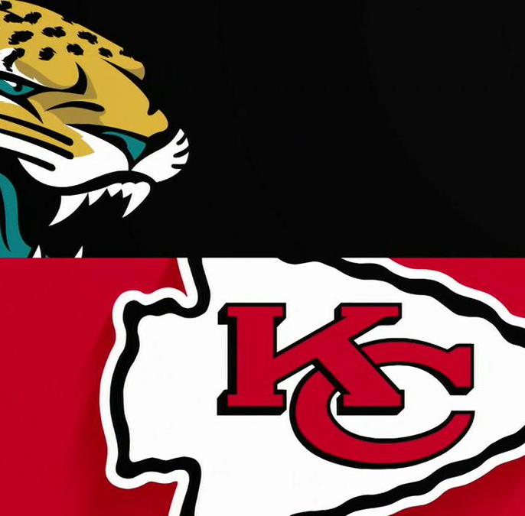

Week 5: Chiefs vs. Jaguars
Andrew Pierson and Kristopher Profit

Slide 2
Agenda
Introduction to Research Question
Pre-Game Sentiment Analysis
Post-Game Sentiment Analysis
Observations
Analysis
Word Cloud
Conclusion

Slide 3
Introduction to Research Question
How will a win or loss affect the sentiment of fanbase tweets in week 5 of the NFL regular season?
Tweets
Coordinates from home stadium
50 KM radius
#Chiefs and #duuval
Sentiment Analysis
Define and categorize opinions

Slide 4
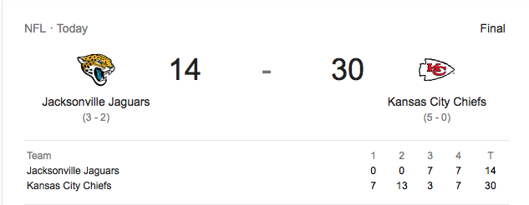
Results of the Game
from: google.com

Slide 5
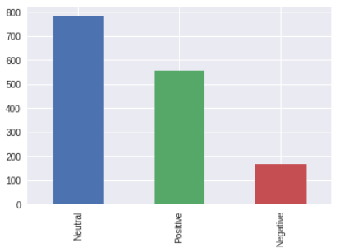
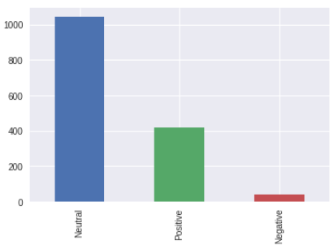
Pre-Game Sentiment
Kansas City Chiefs
Jacksonville Jaguars

Slide 6
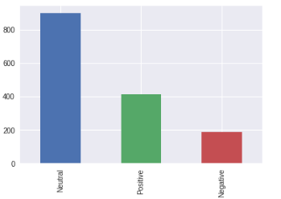
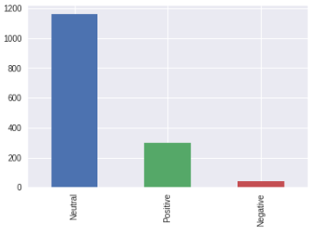
Post-Game Sentiment
Kansas City Chiefs
Jacksonville Jaguars

Slide 7
Observations
Kansas City Chiefs
Jacksonville Jaguars
Neutral sentiment count increased from ~800 to ~900
Positive sentiment count decreased from ~550 to ~400
Negative sentiment count increased from ~175 to ~200
Neutral sentiment count increased from ~1050 to ~1150
Positive sentiment count decreased from ~400 to ~300
Negative sentiment count remained unchanged ay ~50

Slide 8
Analysis
Unexpected results of sentiment distributions
Why not more positive Chiefs Tweets?
Why more negative Chiefs Tweets?
Need to determine if distribution results match the actual Tweet text

Slide 9
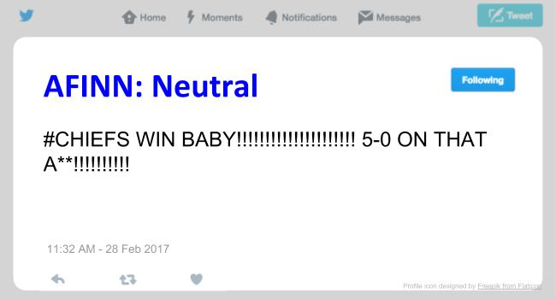
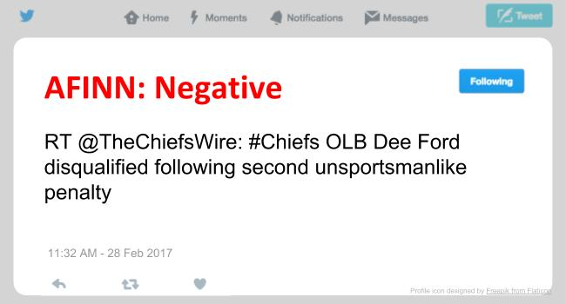
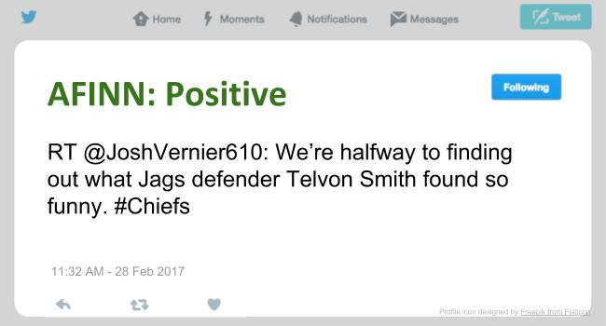
What does the text say?

Slide 10
What does the text say?
Some Positive-sentiment Tweets labeled as Neutral
Context-specific punctuation and emoticons not recognized
Prevents effective analysis
May get better insight looking at commonly occurring words

Slide 11
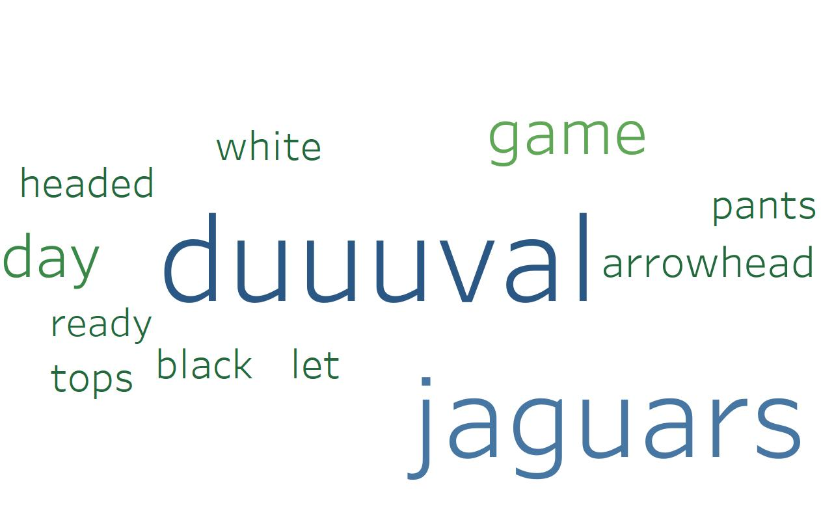
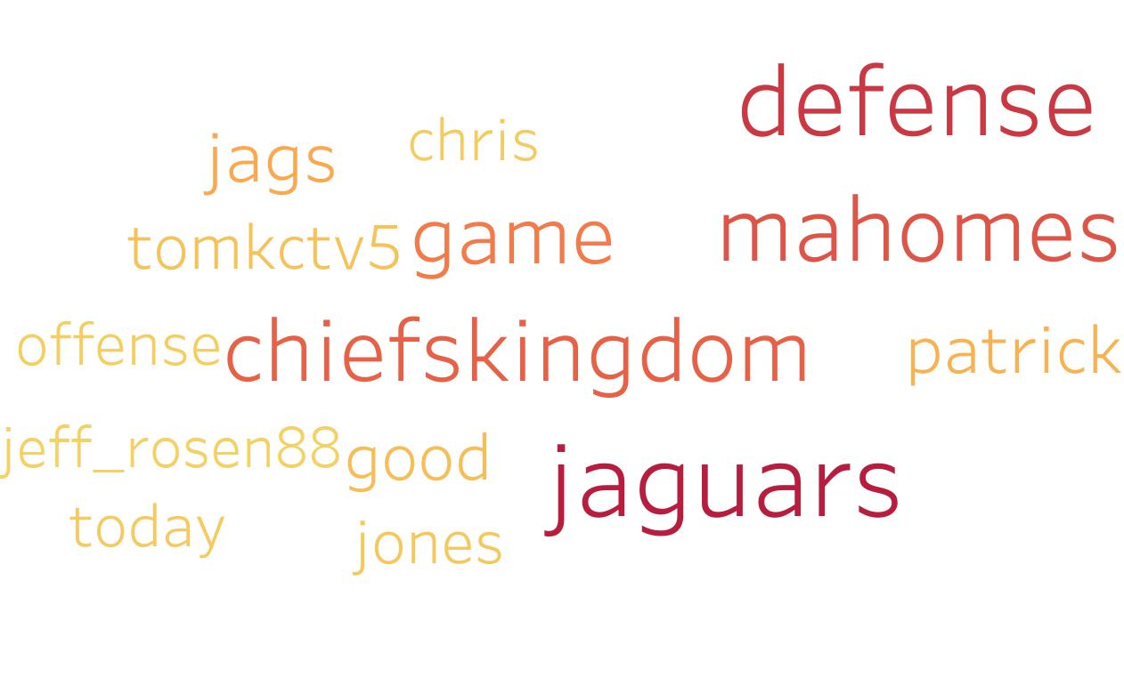
Word Cloud
Kansas City Chiefs
Jacksonville Jaguars
Notes:
Describe the count vectorizer
Describe the results

Slide 12
Conclusion
Ratio of positive to tweets to negative tweets changed differently than hypothesised for winning and losing teams
Sentiment Dictionary not an effective determinant of gauging fans’ attitudes
Looking at most commonly occurring words gave best insight into fan sentiment

